Slide 1
Emergency 911 Call Analysis
IS 525 Data Warehousing and BI
Apurva Padwal
Manpreet Kaur Gurtatta
Vabhavi Tickoo

Slide 2
AGENDA
Background
Dataset Description
Tableau Insights
Challenges

Slide 3



BACKGROUND

Slide 4
BACKGROUND
According to National Emergency Number Association (NENA), “9-1-1 Statistics”, at least 240 million calls to 911 are made each year.
Based on Vera’s analysis, most 911 calls relate to non-criminal issues. Calls are placed predominantly to make nuisance complaints, report low-level offenses, and request well-being checks
OBJECTIVE: To determine the underlying causes and nature of non- violent 911 calls, examine prominent hotspots for emergency help, gauge the stations receiving maximum calls, peak hours of these occurrences

Slide 5
DATASET DESCRIPTION

Slide 6
Dataset Description
Dataset: “911- Calls Historic Data”
Data Source: Kaggle(https://www.kaggle.com/datasets/aayushmishra1512/911calls-historic-data)
Total number of columns: 11
Total number of Rows: 99493

Slide 7
About the Data
Our dataset includes a variety of variables to work with including:
latitude and longitude of the locations from which 911 calls were placed.
brief description of the call
Type of emergency reported
location and time of the occurrence
station that answered it

Slide 8
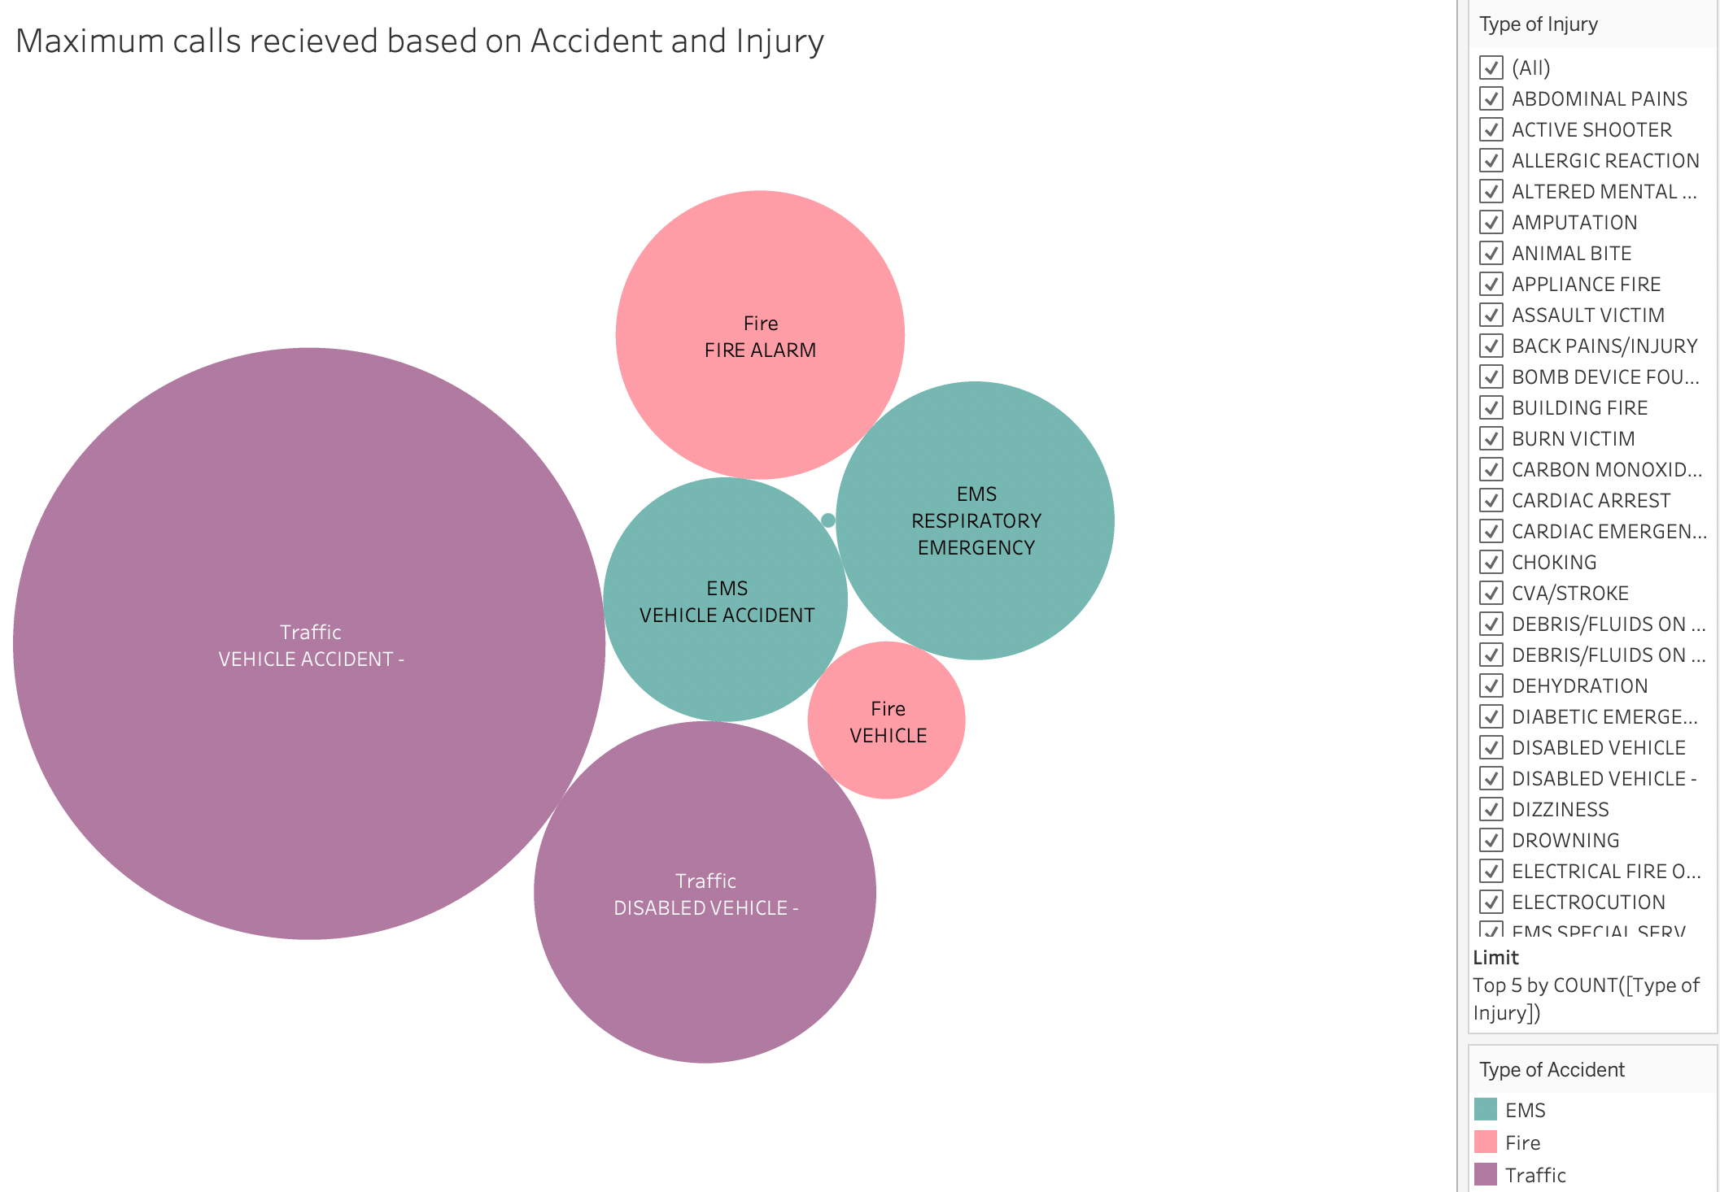
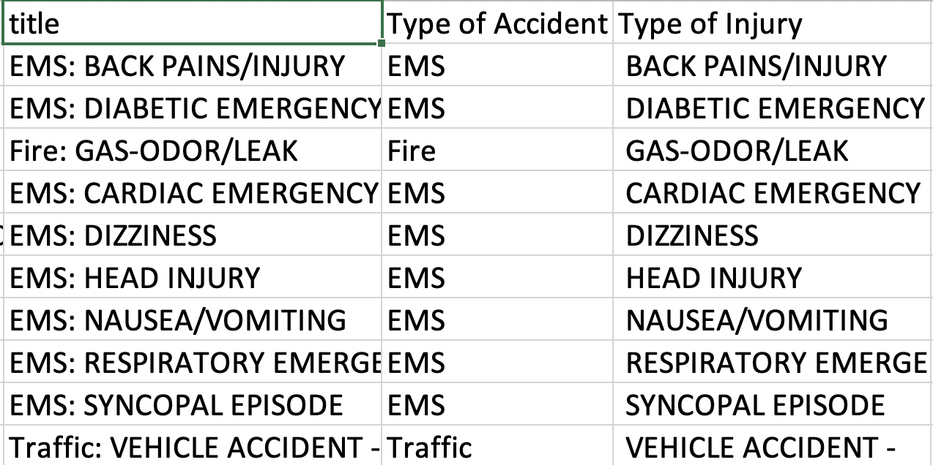
Our Approach
Our first inclination was to categorize our data into 3 basic categories:
EMS
Fire
Traffic

Slide 9

TABLEAU INSIGHTS

Slide 10
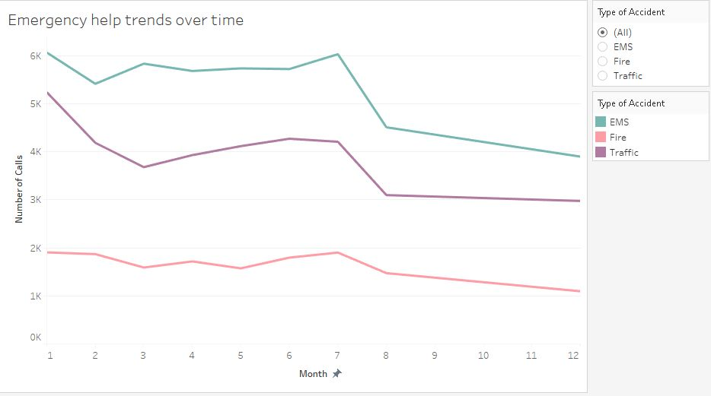
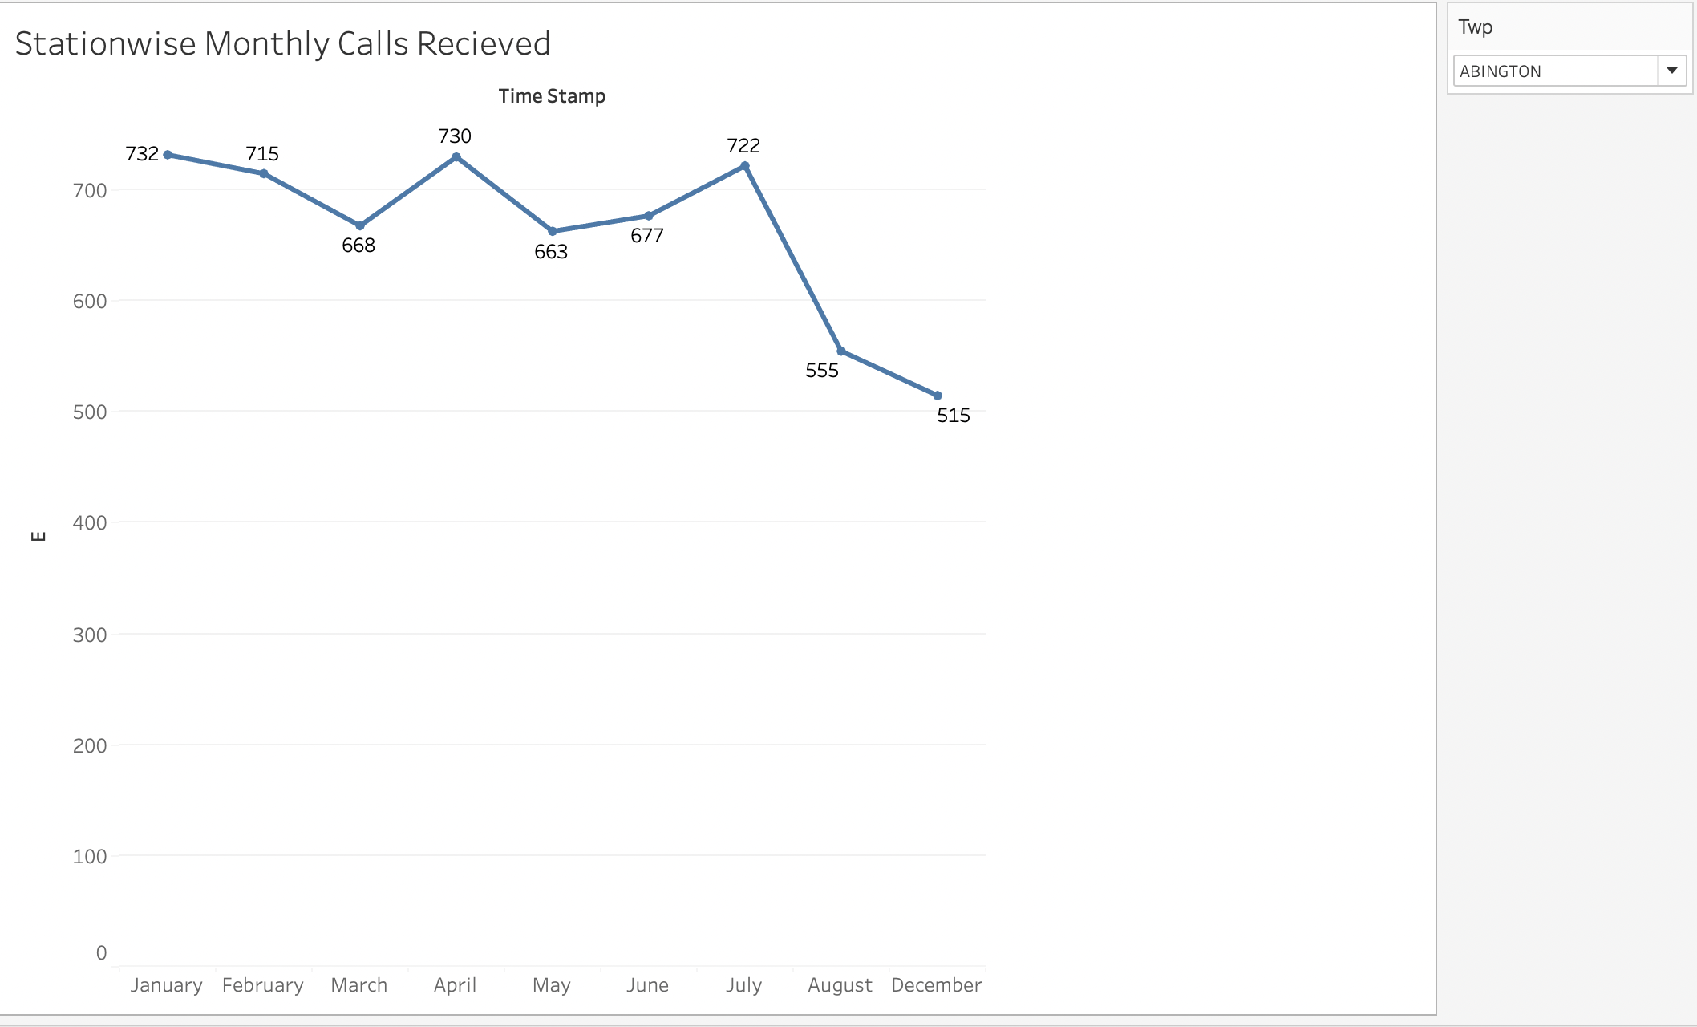
Crimes committed by Month
There is a noticeable fluctuation in crime late summer months.
With the following graphs we observed a decreasing trend in the 911 calls received over time station wise

Slide 11
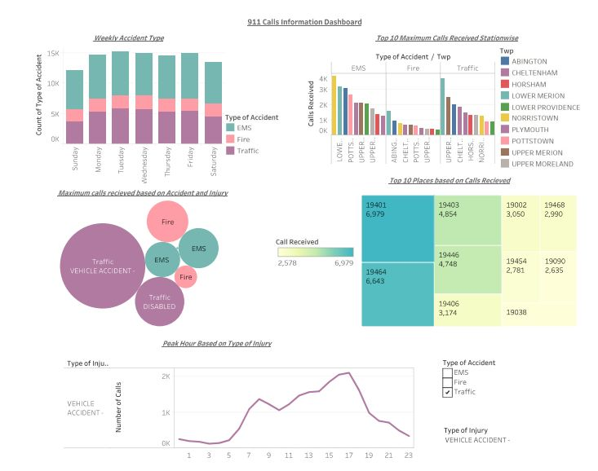
DASHBOARD ANALYSIS

Slide 12
INSIGHTS
“Weekly Accident Type” : displays the probability of the most common accident type occurring each week.
“Maximum calls received based on Accident and injury”: shows the total call statistics for the most common accident and injury kind.
“Peak Hour based on Type of injury” : depicts the most common accident type during a busy time of the day.
“Top 10 Maximum Calls Received Stationwise”: illustrates the Stations that are receiving the most calls for each type of accident.
“Top 10 Places based on Calls Received” : based on the various call records, directs us to the areas that are most prone to accidents.

Slide 13

CHALLENGES

Slide 14
CHALLENGES
Segregating the data
Updating of repots
Switching from Power BI

Slide 15

THANKYOU!

